Slide 1
Lecture- 7
Chapter 6: Parallel dc Circuits
Abu Ahmed Ferdaus, CSE, DU.

Slide 2
This Lecture Includes:
Objectives
Introduction
Parallel Resistors
Total Resistance and Conductance
Parallel Circuits
Power Distribution in a Parallel Circuit
Kirchhoff’s Current Law
Current Divider Rule
Voltage Sources in Parallel
Open and Short Circuits
Voltmeter Loading Effects
Duality: Summary Table
Applications
Abu Ahmed Ferdaus, CSE, DU.

Slide 3
Objectives
Become familiar with the characteristics of a parallel network and how to solve for the voltage, current, and power to each element.
Develop a clear understanding of Kirchhoff’s current law and its importance to the analysis of electric circuits.
Become aware of how the source current will split between parallel elements and how to properly apply the current divider rule.
Clearly understand the impact of open and short circuits on the behavior of a network.
Learn how to use an ohmmeter, voltmeter, and ammeter to measure the important parameters of a parallel network.
Abu Ahmed Ferdaus, CSE, DU.

Slide 4
6.1 Introduction
Two network configurations, series and parallel, form the framework for some of the most complex network structures.
A clear understanding of each will pay enormous dividends as more complex methods and networks are examined.
We will now examine the parallel circuit and all the methods and laws associated with this important configuration.
Abu Ahmed Ferdaus, CSE, DU.

Slide 5
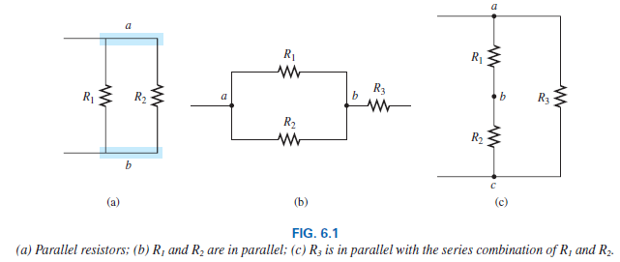
6.2 Parallel Resistors
Two elements, branches, or networks are in parallel if they have two points in common.
Abu Ahmed Ferdaus, CSE, DU.

Slide 6
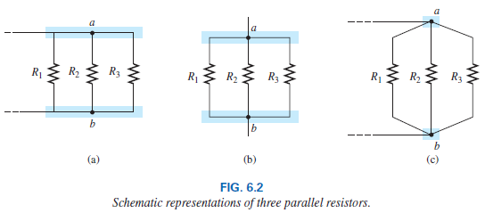
6.2 Parallel Resistors
On schematics, the parallel combination can appear in a number of ways, as shown in Fig. 6.2. The three resistors are in parallel. They all have points a and b in common.
Abu Ahmed Ferdaus, CSE, DU.

Slide 7

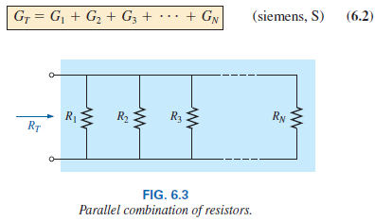
6.2 Total Resistance and Conductance
For resistors in parallel as shown in Fig. 6.3, the total resistance is determined from the following equation:
Since G = 1/R, the equation can also be written in terms of conductance levels as follows:
Abu Ahmed Ferdaus, CSE, DU.

Slide 8

6.2 Total Resistance and Conductance
which is an exact match in format with the equation for the total resistance of resistors in series: R_{T} = R₁ + R₂ + R₃ + . . . + R_{N}.
The result of this duality is that you can go from one equation to the other simply by interchanging R and G.
In general, however, when the total resistance is desired, the following format is applied:
Abu Ahmed Ferdaus, CSE, DU.

Slide 9
6.2 Examples
Example 6.1
Example 6.2
Example 6.3
In general, the total resistance of parallel resistors is always less than the value of the smallest resistor (Above examples also say that). This is particularly important when you want a quick estimate of the total resistance of a parallel combination.
In addition, if the smallest resistor of a parallel combination is much smaller than the other parallel resistors, the total resistance will be very close to the smallest resistor value (Example 6.2).
Abu Ahmed Ferdaus, CSE, DU.

Slide 10
6.2 Examples
Example 6.4
The effect of adding a resistor in parallel of 100 Ω had little effect on the total resistance because its resistance level is significantly higher (and conductance level significantly less) than the other two resistors. The total change in resistance was less than 2%. However, do note that the total resistance dropped with the addition of the 100 Ω resistor.
The introduction of the 1 Ω resistor reduced the total resistance from 2 Ω to only 0.66 Ω —a decrease of almost 67%.
Abu Ahmed Ferdaus, CSE, DU.

Slide 11
6.2 Examples
The fact that the added resistor has a resistance level less than the other parallel elements and one-third that of the smallest contributed to the significant drop in resistance level.
The total resistance of parallel resistors will always drop as new resistors are added in parallel, irrespective of their value.
Recall that this is the opposite of series resistors, where additional resistors of any value increase the total resistance.
Abu Ahmed Ferdaus, CSE, DU.

Slide 12
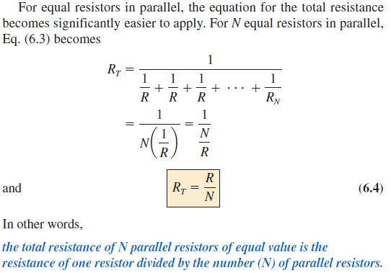
6.2 Equal Resistors in Parallel
Example 6.5
Example 6.6
Abu Ahmed Ferdaus, CSE, DU.

Slide 13
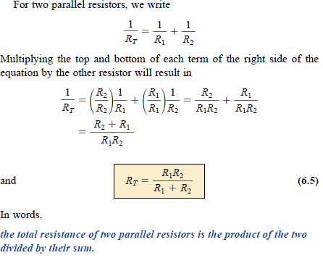
6.2 Special Case: Two Parallel Resistors
Example 6.7
Example 6.8
Abu Ahmed Ferdaus, CSE, DU.

Slide 14
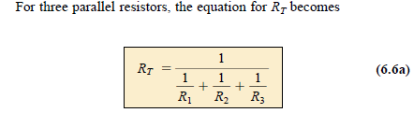
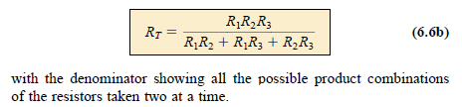
6.2 Special Case: Three Parallel Resistors
Abu Ahmed Ferdaus, CSE, DU.

Slide 15

6.2 Interchanging Parallel Resistors
Example 6.9 (Design Oriented Problem)
Example 6.10
Example 6.11
Abu Ahmed Ferdaus, CSE, DU.

Slide 16
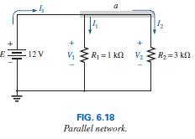
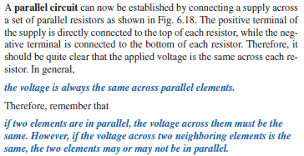
6.3 Parallel Circuits
Abu Ahmed Ferdaus, CSE, DU.

Slide 17
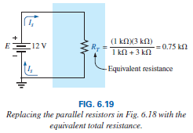

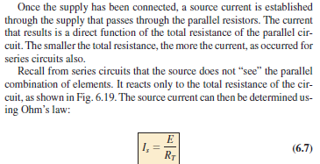
6.3 Parallel Circuits
Abu Ahmed Ferdaus, CSE, DU.

Slide 18

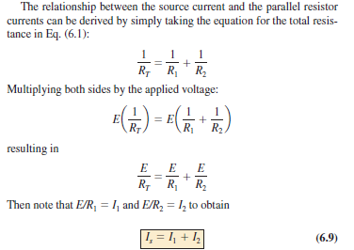
6.3 Parallel Circuits
Abu Ahmed Ferdaus, CSE, DU.

Slide 19
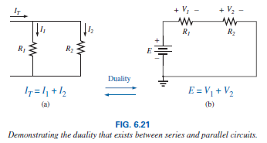
6.3 Parallel Circuits
The result reveals a very important property of parallel circuits: For single-source parallel networks, the source current (I_{s}) is always equal to the sum of the individual branch currents.
Again, for a parallel circuit, the source current equals the sum of the branch currents, while for a series circuit, the applied voltage equals the sum of the voltage drops.
Abu Ahmed Ferdaus, CSE, DU.

Slide 20
6.3 Parallel Circuits
Example 6.12
Example 6.13
In general, for parallel resistors, the greatest current will exist in the branch with the least resistance.
A more powerful statement is that current always seeks the path of least resistance.
Example 6.14
Abu Ahmed Ferdaus, CSE, DU.

Slide 21
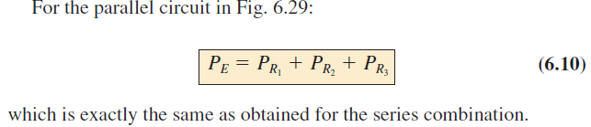
6.4 Power Distribution in a Parallel Circuit
Recall from the discussion of series circuits that the power applied to a series resistive circuit equals the power dissipated by the resistive elements.
The same is true for parallel resistive networks. In fact, for any network composed of resistive elements, the power applied by the battery will equal that dissipated by the resistive elements.
Abu Ahmed Ferdaus, CSE, DU.

Slide 22
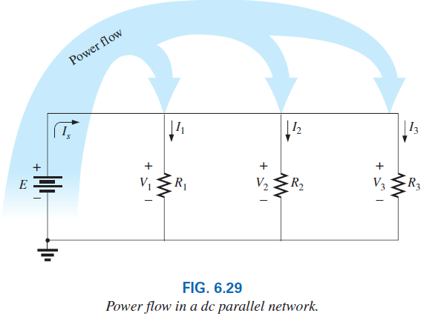
6.4 Power Distribution in a Parallel Circuit
Abu Ahmed Ferdaus, CSE, DU.

Slide 23
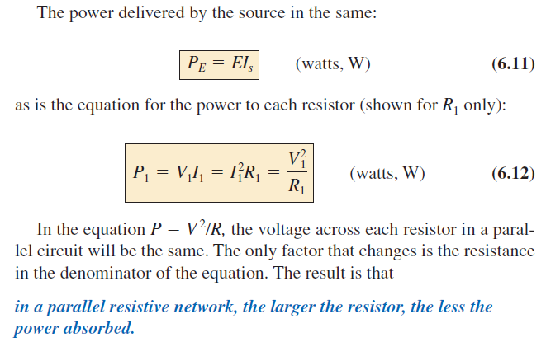
6.4 Power Distribution in a Parallel Circuit
Example 6.15
Abu Ahmed Ferdaus, CSE, DU.

Slide 24
6.5 Kirchhoff’s Current Law
Kirchhoff’s voltage law provides an important relationship among voltage levels around any closed loop of a network.
Professor Gustav Kirchhoff is also credited with developing the following equally important relationship between the currents of a network, called Kirchhoff’s current law (KCL):
KCL states that the algebraic sum of the currents entering and leaving an area, system, or junction is zero.
In other words, the sum of the currents entering an area, system, or junction must equal the sum of the currents leaving the area, system, or junction.
Abu Ahmed Ferdaus, CSE, DU.

Slide 25

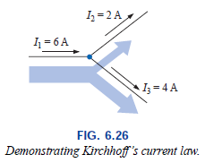
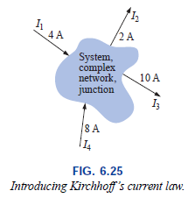


6.5 Kirchhoff’s Current Law
Abu Ahmed Ferdaus, CSE, DU.

Slide 26
6.5 Kirchhoff’s Current Law: Examples
Example 6.16
Example 6.17
Example 6.18
Example 6.19
Direction of unknown current
Example 6.20 (IC)
Abu Ahmed Ferdaus, CSE, DU.

Slide 27
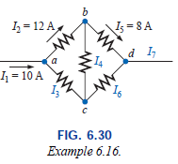
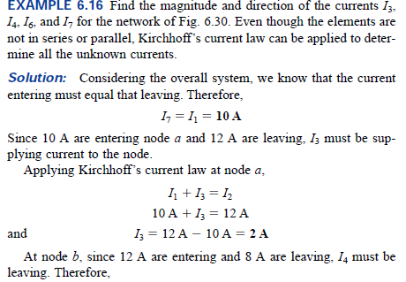
6.5 Kirchhoff’s Current Law
Abu Ahmed Ferdaus, CSE, DU.

Slide 28
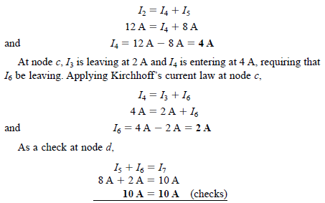
6.5 Kirchhoff’s Current Law
Abu Ahmed Ferdaus, CSE, DU.

Slide 29
6.5 Kirchhoff’s Current Law
The application of Kirchhoff’s current law is not limited to networks where all the internal connections are known or visible. For instance, by treating an integrated circuit (IC) (which could contain over a million elements) as a single node, we can apply Kirchhoff’s current law.
On many occasions, the direction of the unknown current is not provided. With so many currents entering or leaving the system, it is difficult to know by inspection which direction should be assigned to unknown current.
In such cases, simply make an assumption about the direction and then check out the result. If the result is negative, the wrong direction was assumed. If the result is positive, the correct direction was assumed. In either case, the magnitude of the current will be correct.
Abu Ahmed Ferdaus, CSE, DU.

Slide 30
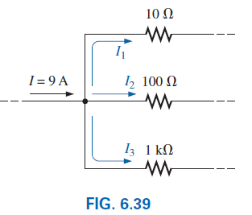
6.6 Current Divider Rule
For series circuits we have the powerful voltage divider rule (VDR) for finding the voltage across a resistor in a series circuit.
We now introduce the equally powerful current divider rule (CDR) for finding the current through a resistor in a parallel circuit.
Abu Ahmed Ferdaus, CSE, DU.

Slide 31
6.6 Current Divider Rule
We already know current will always seek the path of least resistance.
In general,
For two parallel elements of equal value, the current will divide equally.
For parallel elements with different values, the smaller the resistance, the greater the share of input current.
For parallel elements of different values, the current will split with a ratio equal to the inverse of their resistor values.
Example 6.21
Abu Ahmed Ferdaus, CSE, DU.

Slide 32
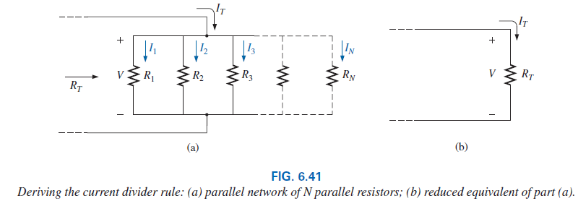

6.6 Current Divider Rule
The current divider rule is particularly important if only the total entering current and resistances are known.
Abu Ahmed Ferdaus, CSE, DU.

Slide 33
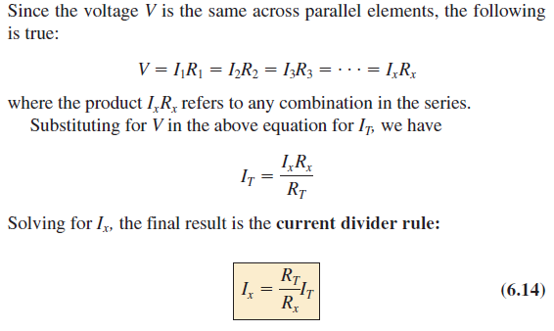
6.6 Current Divider Rule
Abu Ahmed Ferdaus, CSE, DU.

Slide 34
6.6 Current Divider Rule
which states that the current through any branch of a parallel resistive network is equal to the total resistance of the parallel network divided by the resistor of interest and multiplied by the total current entering the parallel configuration.
Since R_{T} and I_{T} are constants, for a particular configuration the larger the value of R_{x} (in the denominator), the smaller the value of I_{x} for that branch, confirming the fact that current always seeks the path of least resistance.
Example 6.22
Also note that, for a parallel network, the current through the smallest resistor will be very close to the total entering current if the other parallel elements of the configuration are much larger in magnitude.
Abu Ahmed Ferdaus, CSE, DU.

Slide 35
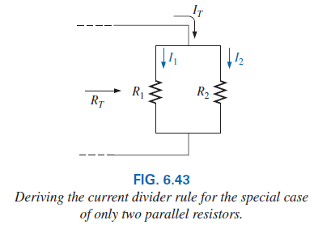
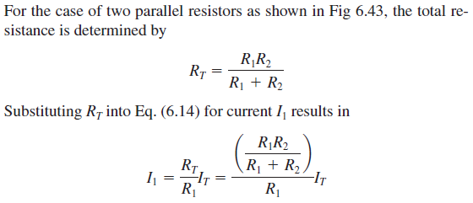


6.6 CDR: Special Case: Two Parallel Resistors
Abu Ahmed Ferdaus, CSE, DU.

Slide 36
6.6 CDR: Special Case: Two Parallel Resistors
Eq. (6.15) states that
for two parallel resistors, the current through one is equal to the other resistor times the total entering current divided by the sum of the two resistors.
Since the combination of two parallel resistors is probably the most common parallel configuration, the simplicity of the format for Eq. (6.15) suggests that it is worth memorizing.
Take particular note, however, that the denominator of the equation is simply the sum, not the total resistance, of the combination.
Example 6.23
Example 6.24 – design type problem
Abu Ahmed Ferdaus, CSE, DU.

Slide 37
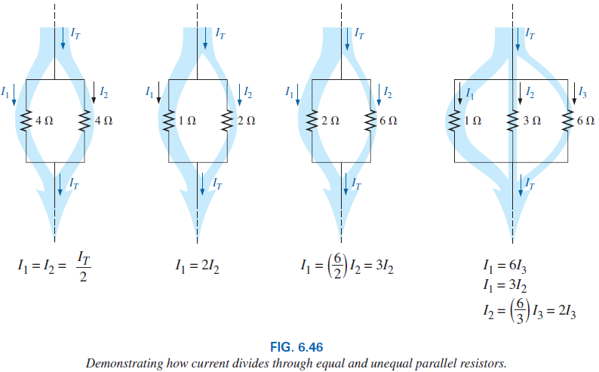
6.6 CDR: Summary
In summary, remember that current always seeks the path of least resistance, and the ratio of the resistor values is the inverse of the resulting current levels, as shown in Fig 6.46 and The thickness of the blue bands reflects the relative magnitude of the current in each branch.
Abu Ahmed Ferdaus, CSE, DU.

Slide 38
6.7 Voltage Sources in Parallel
Because the voltage is the same across parallel elements, voltage sources can be placed in parallel only if they have the same voltage.
The primary reason for placing two or more batteries or supplies in parallel is to increase the current rating above that of a single supply.
For example, in Fig 6.47, two ideal batteries of 12 V have been placed in parallel. The total source current using Kirchhoff’s current law is now the sum of the rated currents of each supply.
The resulting power available will be twice that of a single supply if the rated supply current of each is the same. That is,
Abu Ahmed Ferdaus, CSE, DU.

Slide 39
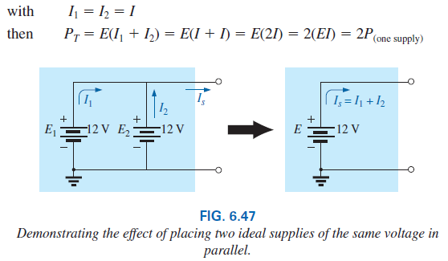
6.7 Voltage Sources in Parallel
Abu Ahmed Ferdaus, CSE, DU.

Slide 40
6.7 Voltage Sources in Parallel
If for some reason two batteries of different voltages are placed in parallel, both will become ineffective or damaged because the battery with the larger voltage rapidly discharges through the battery with the smaller terminal voltage.
For example, consider two lead-acid batteries of different terminal voltages placed in parallel as shown in Fig 6.48.
It makes no sense to talk about placing an ideal 12 V battery in parallel with a 6 V battery, because Kirchhoff’s voltage law would be violated.
However, we can examine the effects if we include the internal resistance levels as shown in Fig. 6.48.
Abu Ahmed Ferdaus, CSE, DU.

Slide 41
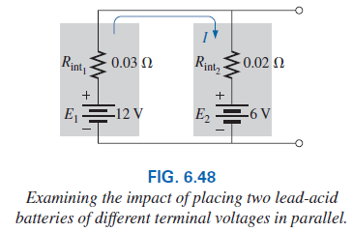
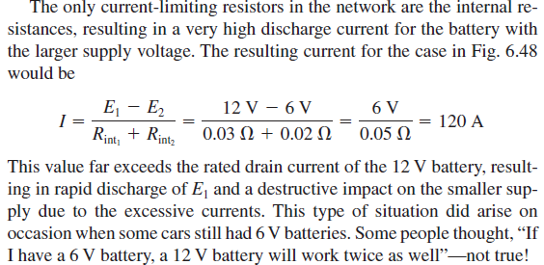
6.7 Voltage Sources in Parallel
Abu Ahmed Ferdaus, CSE, DU.

Slide 42
6.7 Voltage Sources in Parallel
In general,
it is always recommended that when you are replacing batteries in series or parallel, all the batteries be replaced.
A fresh battery placed in parallel with an older battery probably has a higher terminal voltage and immediately starts discharging through the older battery.
In addition, the available current is less for the older battery, resulting in a higher-than-rated current drain from the newer battery when a load is applied.
Abu Ahmed Ferdaus, CSE, DU.

Slide 43
6.8 Open and Short Circuits
Open circuits and short circuits can often cause more confusion and difficulty in the analysis of a system than standard series or parallel configurations.
An open circuit is two isolated terminals not connected by an element of any kind, as shown in Fig. 6.49(a).
Since a path for conduction does not exist, the current associated with an open circuit must always be zero.
The voltage across the open circuit, however, can be any value, as determined by the system it is connected to. In summary, therefore,
An open circuit can have a potential difference (voltage) across its terminals, but the current is always zero amperes.
Abu Ahmed Ferdaus, CSE, DU.

Slide 44
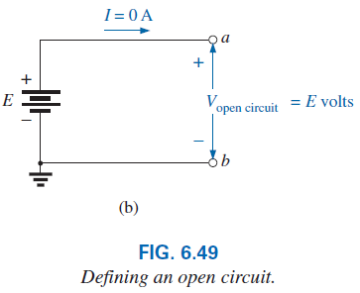
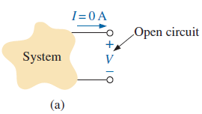
6.8 Open and Short Circuit
In Fig. 6.49(b), an open circuit exists between terminals a and b. The voltage across the open-circuit terminals is the supply voltage, but the current is zero due to the absence of a complete circuit.
Abu Ahmed Ferdaus, CSE, DU.

Slide 45
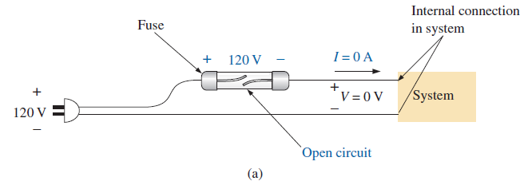
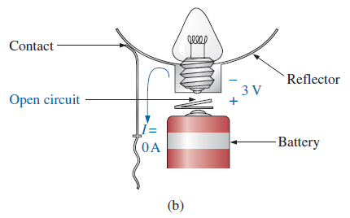
6.8 Open Circuit: Some Practical Examples
Abu Ahmed Ferdaus, CSE, DU.

Slide 46
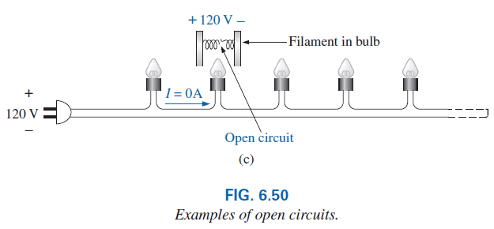
6.8 Open Circuit: Some Practical Examples
Abu Ahmed Ferdaus, CSE, DU.

Slide 47
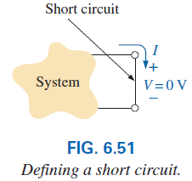
6.8 Short Circuit
A short circuit is a very low resistance, direct connection between two terminals of a network, as shown in Fig. 6.51.
The current through the short circuit can be any value, as determined by the system it is connected to, but the voltage across the short circuit is always zero volts because the resistance of the short circuit is assumed to be essentially zero ohms and V = IR = I(0 ) Ω = 0 V.
In summary, therefore,
A short circuit can carry a current of a level determined by the external circuit, but the potential difference (voltage) across its terminals is always zero volts.
Abu Ahmed Ferdaus, CSE, DU.

Slide 48
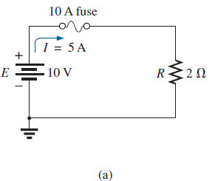
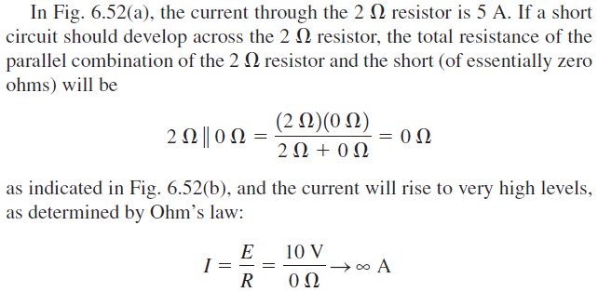
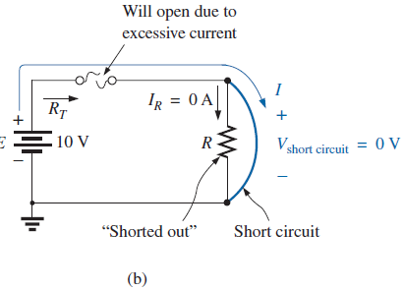
6.8 Short Circuit
The effect of the 2 Ω resistor has effectively been “shorted out” by the low-resistance connection. The maximum current is now limited only by the circuit breaker or fuse in series with the source.
Abu Ahmed Ferdaus, CSE, DU.

Slide 49
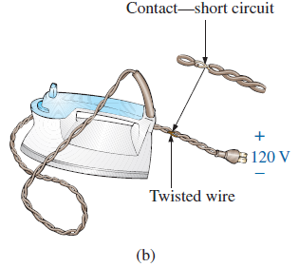
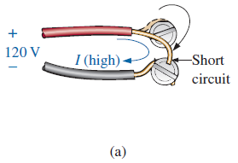
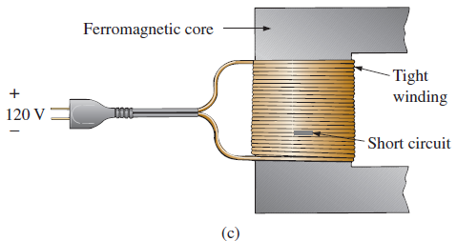
6.8 Short Circuit: Some Practical Examples
Abu Ahmed Ferdaus, CSE, DU.

Slide 50
6.8 Open and Short Circuit
For the layperson, the terminology short circuit or open circuit is usually associated with dire situations such as power loss, smoke, or fire.
However, in network analysis, both can play an integral role in determining specific parameters about a system.
Most often, however, if a short-circuit condition is to be established, it is accomplished with a jumper—a lead of negligible resistance to be connected between the points of interest.
Establishing an open circuit just requires making sure that the terminals of interest are isolated from each other.
Examples: 6.25, 6.26, 6.27, 6.28
Abu Ahmed Ferdaus, CSE, DU.

Slide 51
6.9 Voltmeter Loading Effects
Ammeters are not ideal instruments. When you insert an ammeter, you actually introduce an additional resistance in series with the branch in which you are measuring the current.
Generally, this is not a serious problem, but it can have a troubling effect on your readings, so it is important to be aware of it.
Voltmeters also have an internal resistance that appears between the two terminals of interest when a measurement is being made.
While an ammeter places an additional resistance in series with the branch of interest, a voltmeter places an additional resistance across the element.
Abu Ahmed Ferdaus, CSE, DU.

Slide 52
6.9 Voltmeter Loading Effects
Since voltmeter appears in parallel with the element of interest, the ideal level for the internal resistance of a voltmeter would be infinite ohms, just as zero ohms would be ideal for an ammeter.
Unfortunately, the internal resistance of any voltmeter is not infinite and changes from one type of meter to another.
Most digital meters have a fixed internal resistance level in the megohm range that remains the same for all its scales.
For example, the meter in Fig. 6.61 has the typical level of 11 MΩ for its internal resistance, no matter which voltage scale is used. When the meter is placed across the 10 kΩ resistor, the total resistance of the combination is
Abu Ahmed Ferdaus, CSE, DU.

Slide 53
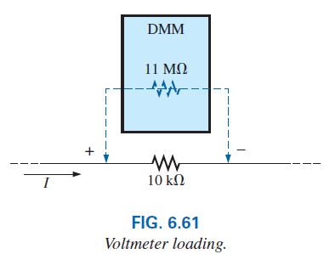

6.9 Voltmeter Loading Effects
and the behavior of the network is not seriously affected.
Most digital voltmeters can be used in circuits with resistances up to the high-kilohm range without concern for the effect of the internal resistance on the reading.
However, if the resistances are in the megohm range, you should investigate the effect of the internal resistance.
Abu Ahmed Ferdaus, CSE, DU.

Slide 54
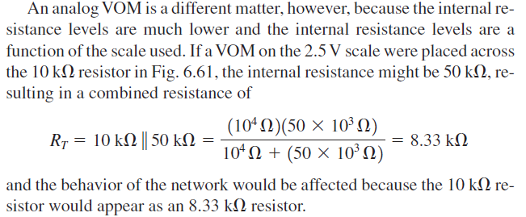
6.9 Voltmeter Loading Effects
Abu Ahmed Ferdaus, CSE, DU.

Slide 55
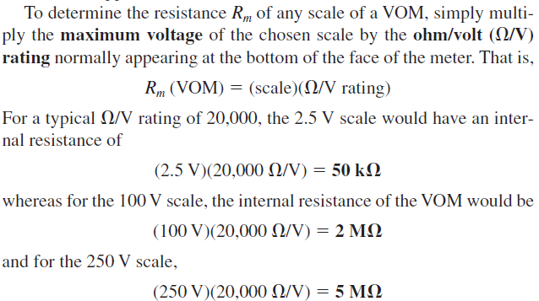
6.9 Voltmeter Loading Effects
Example: 6.29
Abu Ahmed Ferdaus, CSE, DU.

Slide 56
6.10 Duality Principle
The equations for the series and parallel configurations have a number of similarities. In fact, the equations for one can often be obtained directly from the other by simply applying the duality principle.
Duality between equations means that the format for an equation can be applied to two different situations by just changing the variable of interest.
For instance, the equation for the total resistance of a series circuit is the sum of the resistances. By changing the resistance parameters to conductance parameters, you can obtain the equation for the total conductance of a parallel network—an easy way to remember the two equations.
Abu Ahmed Ferdaus, CSE, DU.

Slide 57
6.10 Duality Principle
Similarly, by starting with the total conductance equation, you can easily write the total resistance equation for series circuits by replacing the conductance parameters by resistance parameters.
Series and parallel networks share two important dual relationships:
(1) between resistance of series circuits and conductance of parallel circuits and
(2) between the voltage or current of a series circuit and the current or voltage, respectively, of a parallel circuit.
Next table summarizes this duality.
Abu Ahmed Ferdaus, CSE, DU.

Slide 58
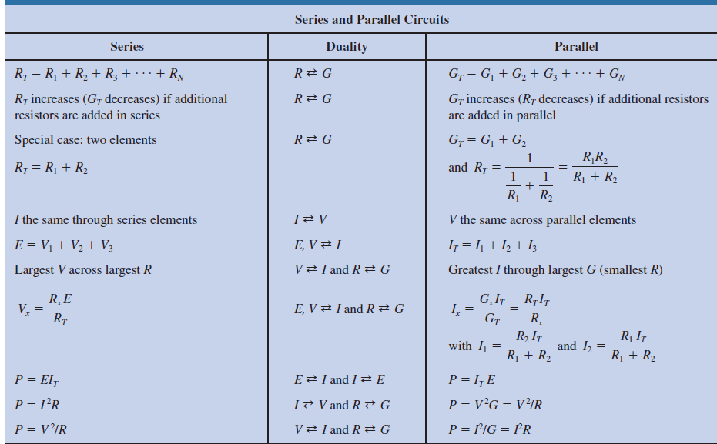
6.10 Summary Table
Abu Ahmed Ferdaus, CSE, DU.

Slide 59
6.13 Applications
One of the most important advantages of the parallel configuration is that if one branch of the configuration should fail (open circuit), the remaining branches will still have full operating power.
Another important advantage is that branches can be added at any time without affecting the behavior of those already in place.
Some Common Applications are:
1. Car System
2. House Wiring
3. Parallel Computer Bus Connections
Abu Ahmed Ferdaus, CSE, DU.

Slide 60
Thank You
Abu Ahmed Ferdaus, CSE, DU.

